Slide 1

A study of NYC’s transit data
Evan Spiller

Slide 2
Non-technical overview
NYC has public data on every rideshare and taxi ride from 2009-2023
This data contains a huge amount of data on New York’s transportation patterns
There are really endless questions that this dataset can answer. Even looking at the file sizes gives you a rough view of pandemic decline and recovery in movement!

Slide 3
Non-technical overview: problem
Context: A huge amount of for-pay rides are < 2 miles. Just in January: New Yorkers spent $54M on rides < 2 miles. This represents a failure of public transit to serve New Yorker’s basic transit needs, increasing traffic and costing New Yorkers money and experiences.
Problem: Increase bus ridership by designing routes with high demand. Furthermore, study the speed by which these patterns change in order to understand the utility of MTA’s multi-year planning process.
Opportunity: create an application that finds the a potential bus route from one location to another that would make the most number of for-pay rides unnecessary. Furthermore, predict how these routes will change over time.

Slide 4
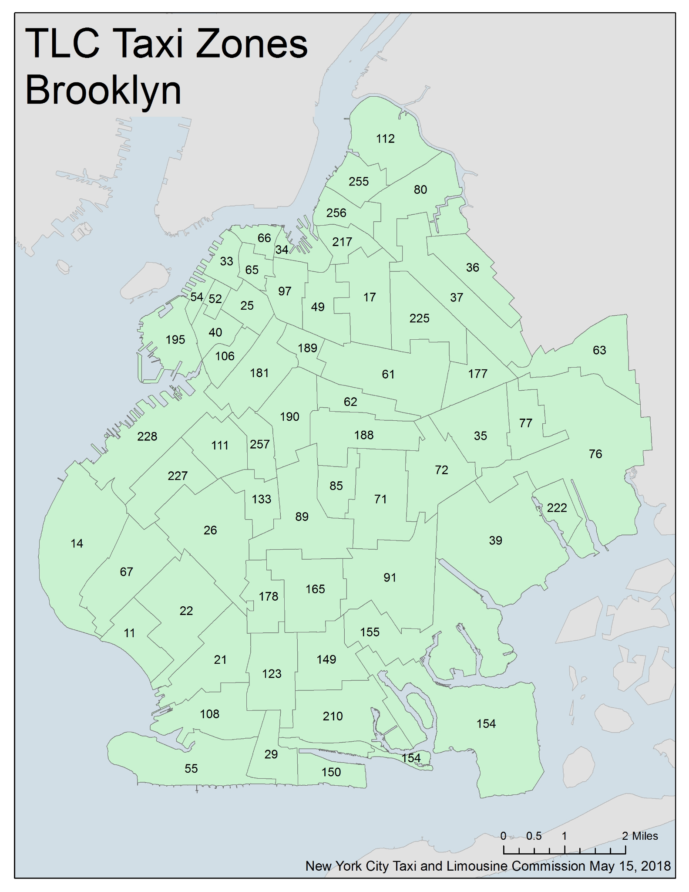
How to tackle this problem with data science
Pick a start and end point by taxi zone.
Using graph algorithms, create an application that lists potential routes where:
The ‘bus’ only travels through adjacent routes
The bus never travels through the same route twice
The bus is limited to a set number of taxi zones
Weight routes by ridership to find ‘best route’
Generalize application so that you can discover ‘best route’ by inputting starting point, end point, time, and number of taxi zones.
Use a moving time window to to predict movement of an optimal route e.g., how will the optimal route for 2013-5 from Astoria to Williamsburg change by 2016.
This will also give a sense of the pace of change of transportation needs

Slide 5
Potential impact
Two potential impacts:
Create a rudimentary tool for deciding and predicting the best bus routes. While there are myriad other considerations such as logistics, specific community needs, and budget that are not being accounted for in my algorithm, this is potentially a valuable tool for policymakers to discover routes that fit transit needs and have the potential to increase ridership.
Examine the pace of change of transportation needs, providing datapoints for citizens and policymakers who wish to examine the utility of MTA’s multi-year planning process.

Slide 6
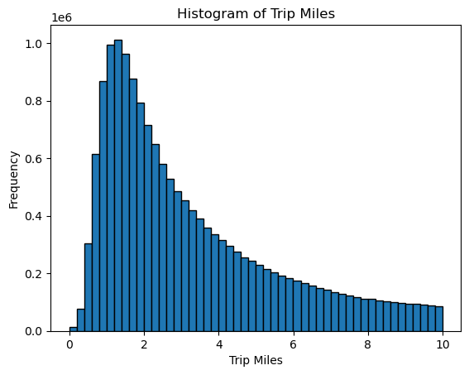
Introduction to the dataset: key findings
Ride length peaks at about one mile then declines exponentially.
(Jan 2023 data)

Slide 7
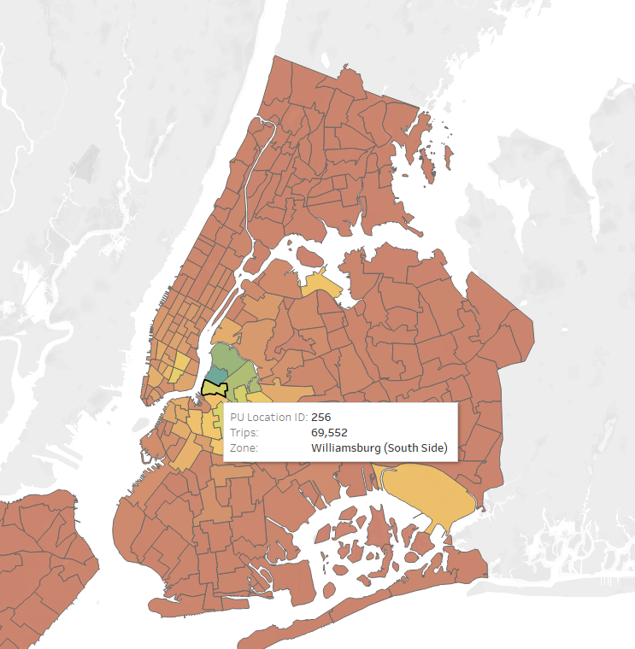
Introduction to the dataset: key findings
Data is split by pickup and dropoff location to taxi districts.
Most taxi districts behave like this: the bulk of rides come from that district and nearby districts as well as JFK and LGA airports.

Slide 8
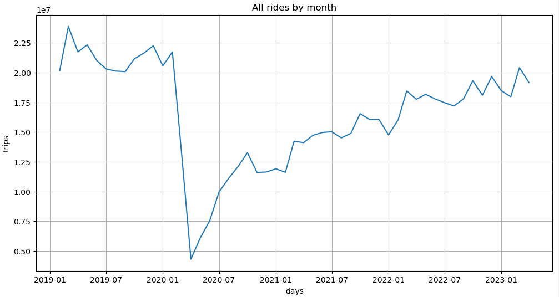
Introduction to the dataset: key findings
Overall, rideshare trips track pandemic behavior, movement and economic recovery.

Slide 9
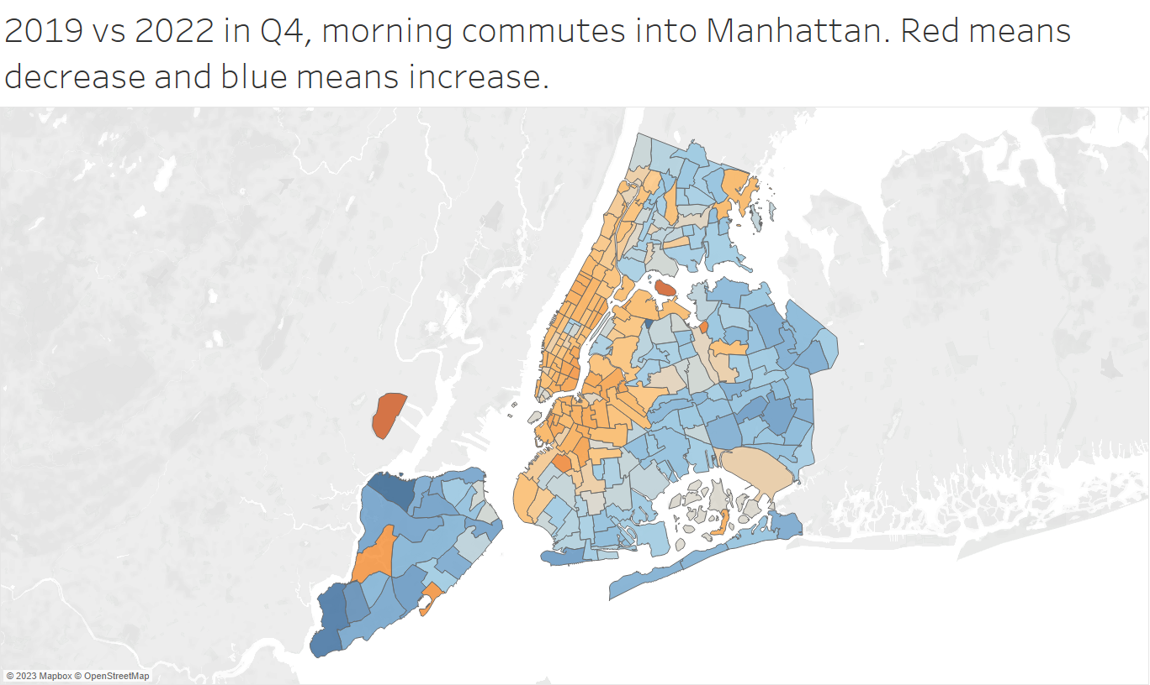
Introduction to the dataset: key findings
This is also a remarkable dataset for studying changes to behavior by neighborhood in NYC, especially pre and post-pandemic.

Slide 10
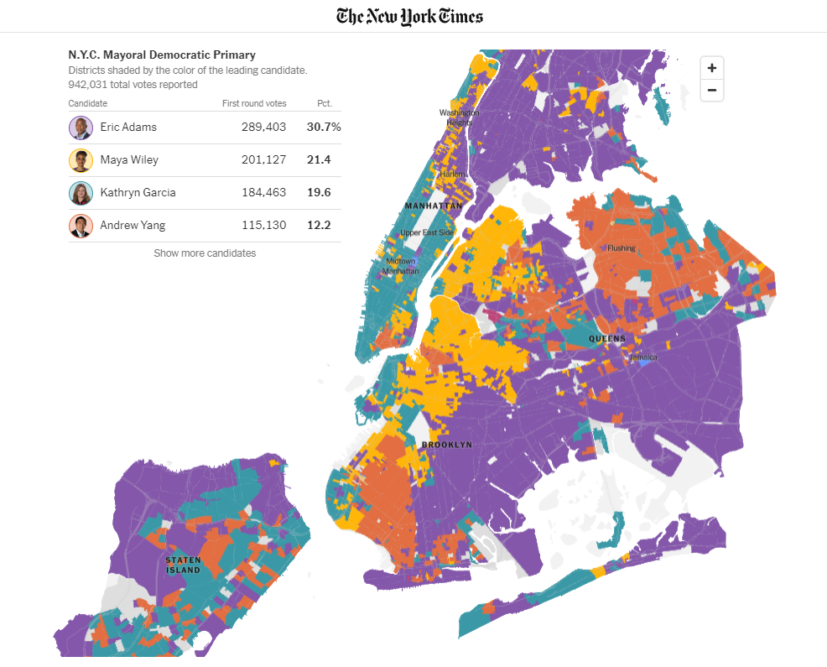
Introduction to the dataset: key findings
Commuter differences are very similar to voting patterns and other maps that demonstrate the difference in lifestyles between inner and outer-borough residents.

Slide 11
Next steps
Complete aggregation of parquet files for yellow cabs and rideshare rides pre-2019.
Continue EDA to visualize travel patterns to specific districts over time.
Analyze shape file to list adjacent districts for each district.
Use graph algorithms to create application for ‘best’ routes from point a to point b.
Observe ‘best route’ change over time and use a moving time window to to predict future optimal routes.

